Slide 1
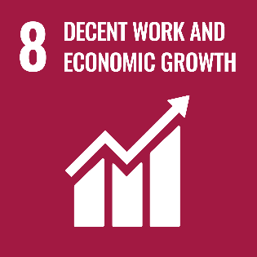
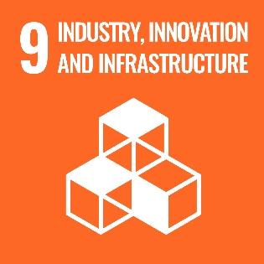
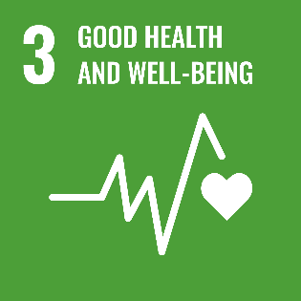
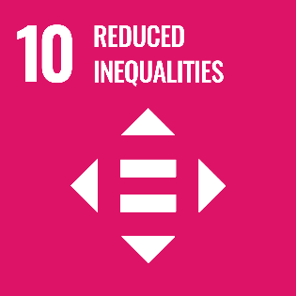
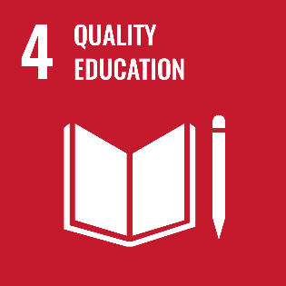
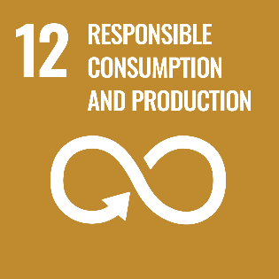
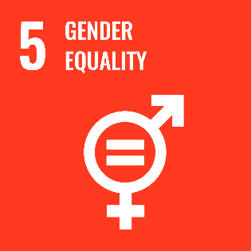
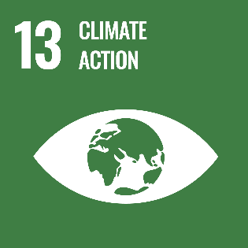
Boeing is proud to be a vital part of the global commercial air travel community which employs over 65 million people worldwide and supports $2.7 trillion in world economic activity (3.6% of global gross domestic product).
In 2019, Boeing and its employees invested more than $240M and 750,000 volunteer hours to help build better communities worldwide.
Boeing contracts with more than 20,000 suppliers and partners globally. In 2019, Boeing partnered with suppliers from 58 countries, including all 50 states. The company bought more than 1.7 billion parts, spending over $58 billion.
The UN Sustainable Development Goals (SDG) are a universal call to action to end poverty, protect the planet and improve the lives and prospects of everyone, everywhere. Boeing supports all 17 SDGs, and has identified eight goals of focus, listed below, in which we are committed to outcomes that make the world a better place for all.
More than 75 percent of Boeing’s commercial research and development funding supports greater efficiency and environmental performance in our products, services, and facilities.
The ecoDemonstrator program has tested 160+ technologies on seven test airplanes and made history by flying the first commercial airliner flight with 100% sustainable aviation fuel.
Our product designs enable disassembly of parts and materials recovery so that our airplanes are nearly 90% recyclable by weight –the Aircraft Fleet Recycling Association, of which Boeing is a founding member, certifies these parts for reuse..
Our Go4Zero initiative prioritizes workplace safety. Since introduction in 2014, Boeing has reduced serious safety incidents by 59 percent and experienced 35 percent fewer injuries.
Boeing provides 12 weeks off with full pay to mother and fathers for the birth, adoption, surrogacy or placement of a foster child.
During the COVID-19 pandemic, Boeing adjusted its operations to ensure employee safety and donated 4 million units of PPE and produced 38,600 3D-printed face shields.
In 2020, we committed $10.6 million in grant funding to 20 nonprofits to support racial equity and social justice nonprofits and programs in the United States.
Over the past five years, Boeing has invested more than $120 million to support underserved communities – including racial equity and social justice programs – across the United States.
In 2020, Boeing established a Racial Justice Task Force and committed to a 20% increase in representation of Black Boeing employees in the U.S. to address racial equity and inclusion.
We support STEM education and seek to inspire the next generation of innovators and contributed nearly $30 million across 254 grants in support of STEM education and workforce development programs in 2019.
In 2019, Boeing invested $8 million in grants to assist with workforce training and development programs to expand the aviation careers pipeline, and support employees in their pursuit of advanced education.
We have invested more than $1 billion in our employees’ college tuition, books and fees through our industry-leading tuition assistance program — the Learning Together Program.
Boeing is committed to reducing greenhouse gas emissions by 25%, water consumption and solid waste to landfill by 20%, energy use by 10% and hazardous waste by 5% by 2025 (compared to 2017 levels).
Carbon-fiber recycling at 11 Boeing sites will divert about 1 million pounds of solid waste to landfill annually.
Boeing’s reuse of shipping containers diverted 900 tons of solid waste from landfills and recycled over 400 tons of corrugated boxes.
The underrepresentation of girls and women in STEM fields is a global challenge. Boeing STEM investments in 2019 inspired an estimated 1 million young women and girls
Boeing is also a global supporter of Catalyst — a recognized leader in gender equity with a mission to accelerate progress for women through workplace inclusion.
We participate in McKinsey’s Women in the Workplace Survey, which provides valuable insights into our pipeline, policies, and employee sentiment and helps guide our efforts to advance gender equity at Boeing.
Each new generation of Boeing airplanes reduces emissions 15-25% more than the previous one and has noise footprints up to 50 percent smaller than their predecessors.
Boeing has the most fuel efficient airplane in every market. The 787 Dreamliner’s fuel savings alone are equivalent to taking 16 million cars off the road for a year.
Boeing factories in Renton, Wash. And Charleston, S.C., as well as sites in Texas and Arizona run on 100% renewable energy—solar, wind or hydropower.

